Slide 1
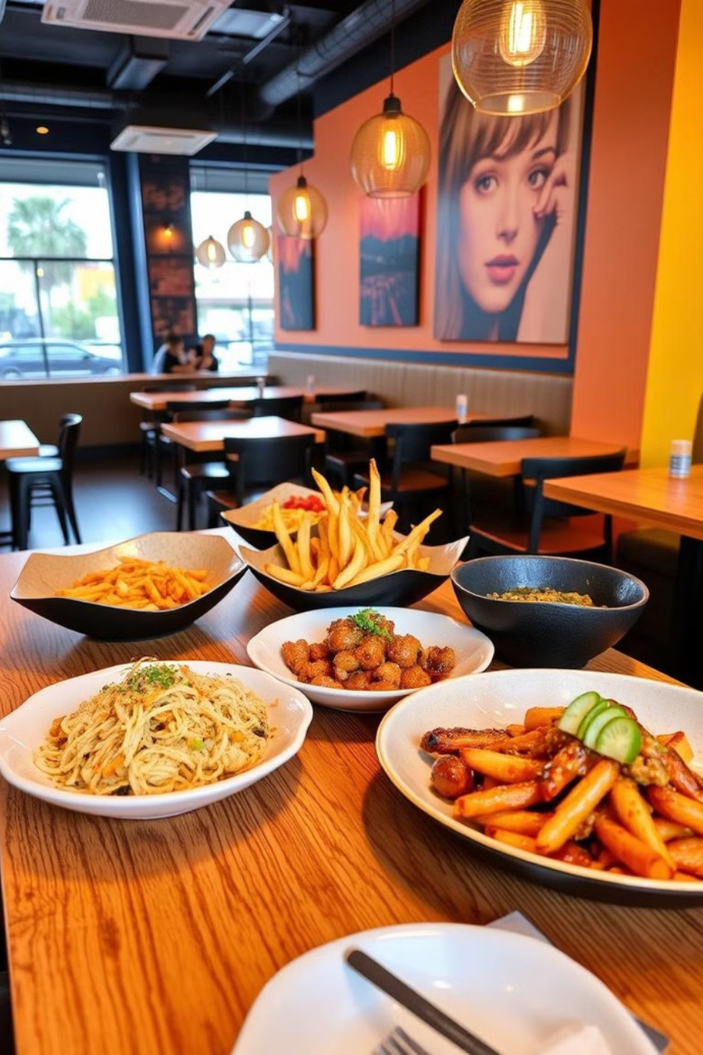
Introduction to our New Food Ordering Apprth
Our new food ordering app offers a seamless and personalized dining experience, making it easier than ever for customers to discover, order, and enjoy their favorite meals. With a focus on convenience, customization, and real-time order tracking, this app is poised to revolutionize the way people interact with their local food scene.

Slide 2
Key Features of the App
Intuitive Navigation
The app's clean and user-friendly interface makes it easy for customers to browse menus, customize orders, and complete the checkout process with just a few taps.
Personalized Recommendations
Using machine learning algorithms, the
app analyzes each user's preferences
and ordering history to suggest
personalized meal options, ensuring a
tailored and delightful experience.
Seamless Payment
Customers can securely save their payment information and checkout quickly, allowing them to focus on enjoying their meal rather than the logistics.

Slide 3
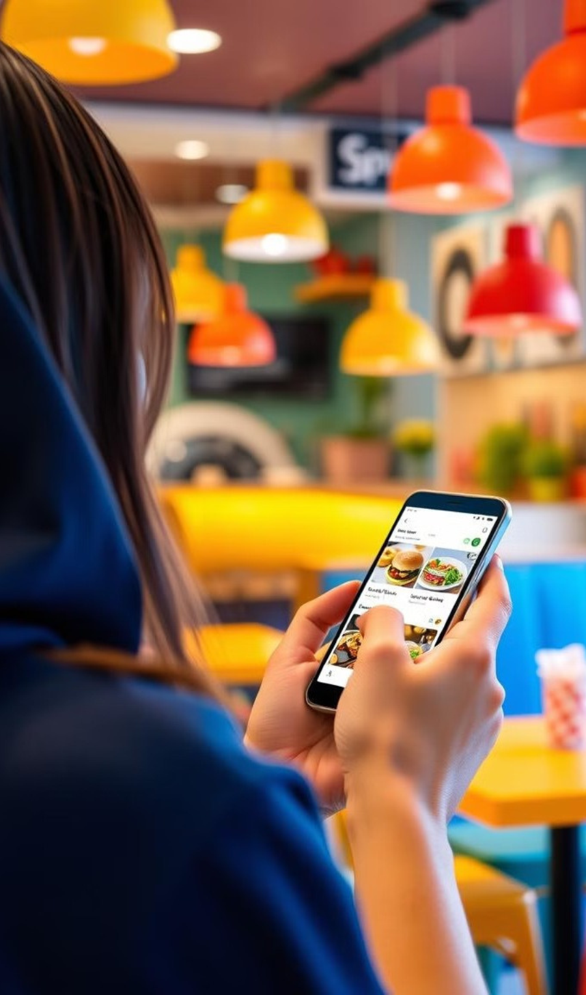
Streamlining the Ordering Process
Browse Menus
Customers can easily navigate through a wide selection of restaurants and cuisines, exploring various menu options.
Customize Orders
With the ability to modify ingredients, add special requests, and save favorite orders, customers have full control over their dining experience.
Complete Checkout
The seamless checkout process, with secure payment options, ensures a smooth and hassle-free ordering experience.

Slide 4

Intuitive User Interface
Responsive Layout
The app's responsive layout ensures optimal usability across various device sizes, providing a consistent experience for customers on-the-go.
Visually Appealing
The app's sleek and visually appealing design, with high quality food imagery, creates an engaging and appetizing user experience.
Intuitive Navigation
The app's intuitive navigation, with clear labeling and logical flow, allows customers to quickly find what they're looking for.
Accessibility
The app's accessibility features, such as text-to-speech and high-contrast modes, ensure an inclusive experience for all users.

Slide 5
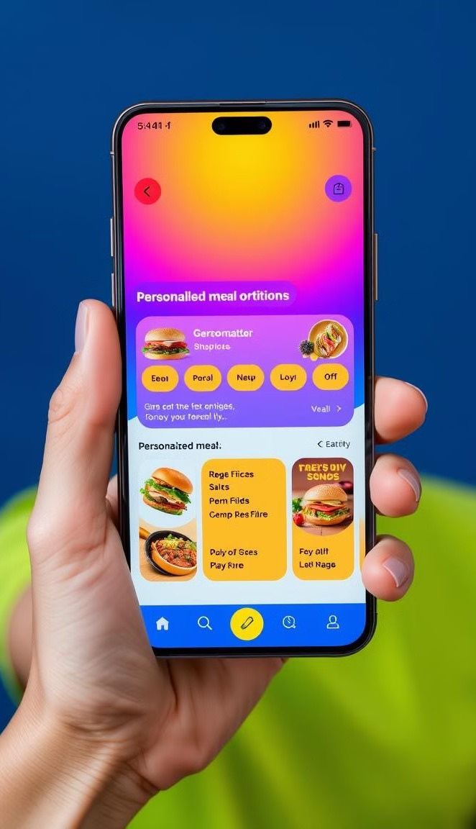
Personalized Recommendations
1 . Dietary Preferences
The app considers each user's dietary restrictions and preferences, offering tailored meal suggestions that cater to their unique needs.
2 . Past Ordering History
By analyzing a user's previous orders, the app is able to provide personalized recommendations that align with their tastes and favorites
4 . Seasonal and Trending Items
The app leverages location data to recommend nearby restaurants and dishes that are popular in the user's local area. The app stays up-to-date with the latest food trends and seasonal offerings, ensuring customers are always presented with fresh and relevant options.
3 . Location-based Suggestions
The app leverages location data to recommend nearby restaurants and dishes that are popular in the user's local area.

Slide 6
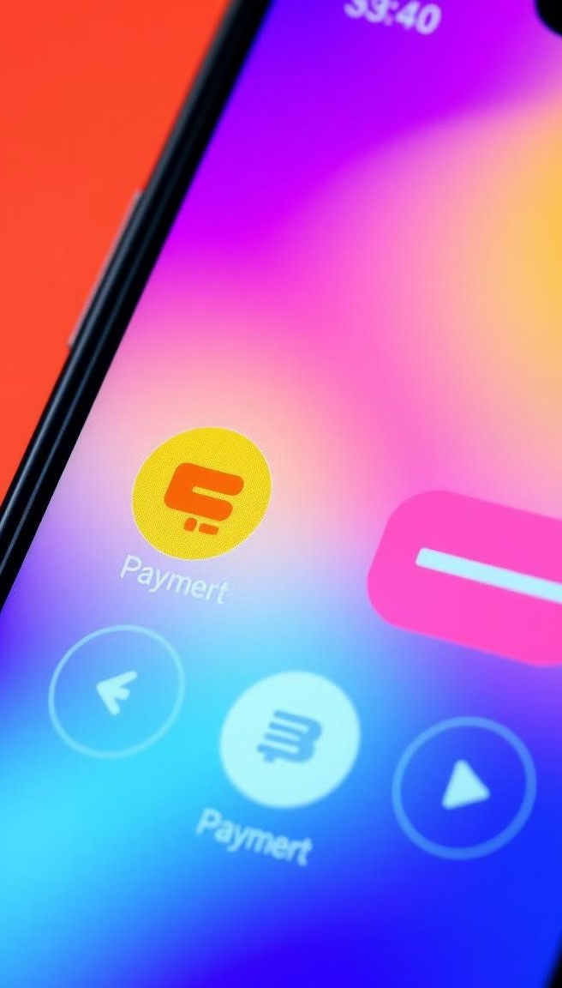



Seamless Payment Integration
Mobile Wallets
The app supports popular mobile payment options, such as Apple Pay and Google Pay, for a seamless and secure checkout experience.
Credit/Debit Cards Customers can securely store their credit and debit card information for fast and convenient checkout.
Gift Cards
Customers can easily redeem and apply digital gift cards to their orders, adding an extra layer of flexibility and convenience.
Contactless Payment
The app supports contactless payment methods, allowing customers to complete their orders without the need to handle cash or cards.

Slide 7
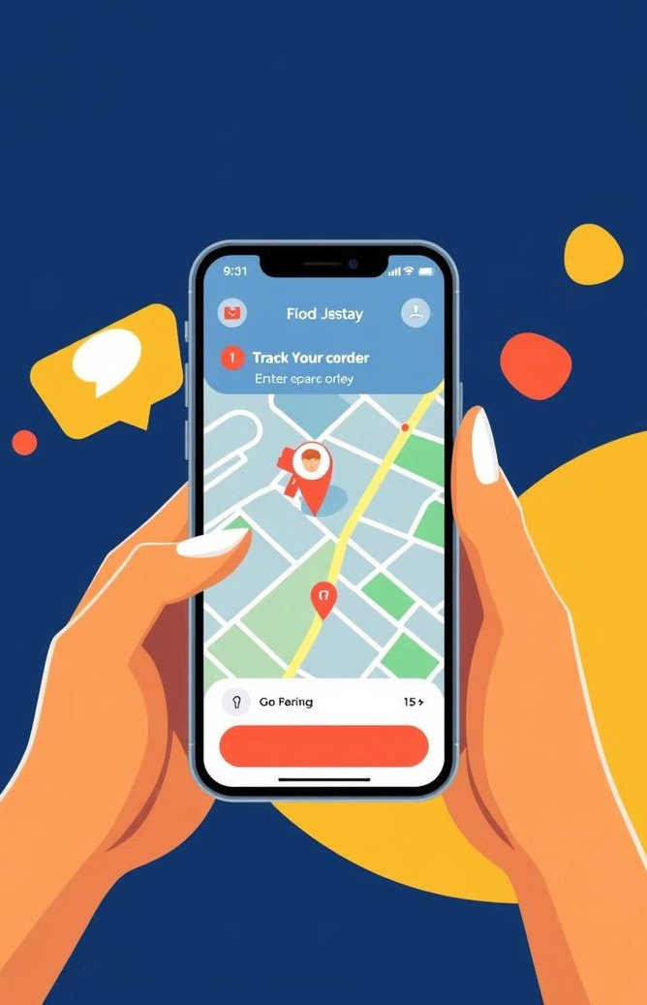
Real-Time Order Tracking
Order Placed
Customers receive real-time updates on the status of their order, from the moment it is placed to when it is on route for delivery.
Order Prepared
The app provides live updates on the order preparation process, keeping customers informed on the progress of their meal.
Order Delivered
Customers can track the delivery driver's location and estimated time of arrival, ensuring they are ready to receive their order

Slide 8

Scalable Infrastructure
High Availability
Elastic Scaling The app's infrastructure is designed for maximum uptime and resilience, ensuring customers can access the service at all times.
Elastic Scaling
The app can automatically scale its resources to handle fluctuations in user demand, providing a consistent experience during peak hours. Robust Security Reliable Performance
Robust Security
The app's security measures, including encryption and fraud detection, protect customer data and transactions.
Reliable Performance
The app's infrastructure is optimized for low latency and high throughput, ensuring fast and responsive service for users.

Slide 9
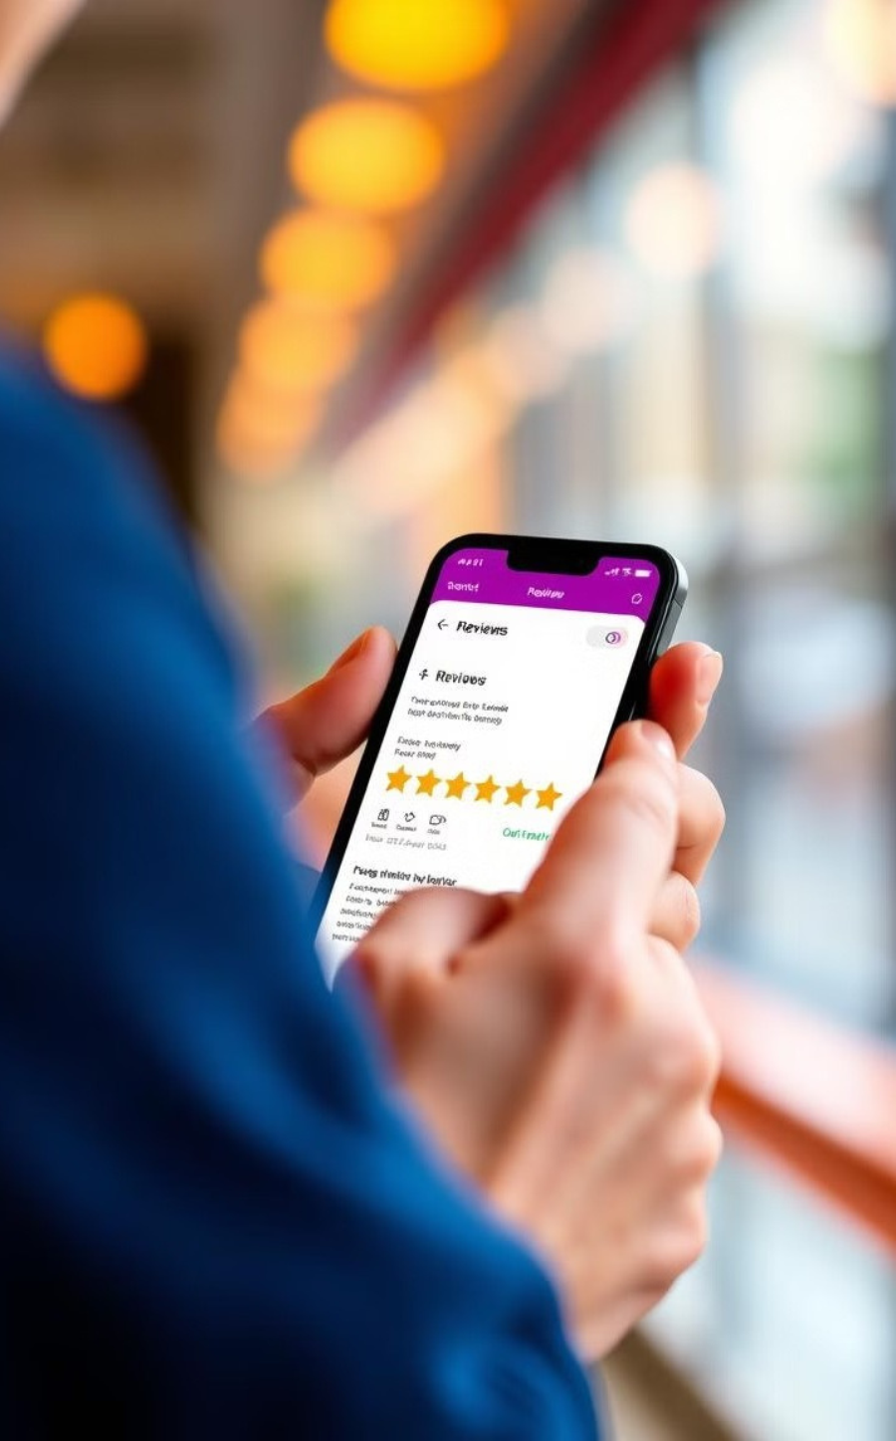
Feedback and Continuous Improvement
Customer Feedback
The app encourages users to share their feedback, suggestions, and any issues they encounter, enabling the team to continuously improve the service.
Data-Driven Insights
By analyzing user behavior and performance metrics, the app's development team can identify areas for improvement and implement new features to enhance the user experience.
Regular Updates
The app is regularly updated with bug fixes, feature enhancements, and new capabilities, ensuring it remains a cutting-edge and reliable solution for customers

Slide 10

Conclusion and Next Steps
Our new food ordering app is designed to revolutionize the way customers discover, order, and enjoy their favorite meals. By combining intuitive features, seamless integration, and a scalable infrastructure, we are committed to delivering an exceptional dining experience that sets a new standard in the industry.
As we move forward, we will continue to gather feedback, analyze data, and implement innovative improvements to ensure our app remains at the forefront of the food ordering landscape. We are excited to embark on this journey with our customers and look forward to shaping the future of convenient and personalized dining.

